Slide 1
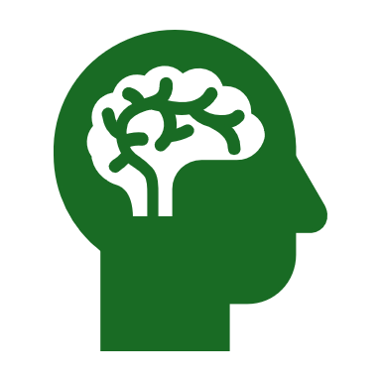
Introduction to Psychology- I
LA380 / LAL320

Slide 2
Topics to be Covered
Biology of Behaviour: Species typical behaviour patterns – Brain and behaviour – neurons and synapses – the nervous system and its functions in behaviour- hemispheric functions- neural degeneration and neural regeneration- blocking neural degeneration
Principles of learning – definition and perspectives of learning, classical conditioning, instrumental conditioning- Thorndike, Skinner- reinforcement-schedules of reinforcement- role of aversive stimuli- applications- cognitive learning theory - learning and the brain

Slide 3
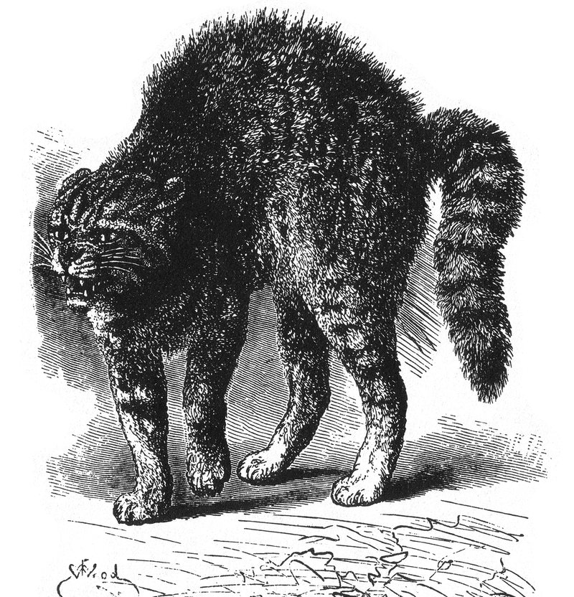
Species typical behaviour patterns
Ethology and Ethologists: Study of behaviour patterns typical of of particular species of animals- with emphasis on the evolution of these patterns and adaptive value.
Species Typical behaviour:
All normal members must display the behaviour under certain circumstances.
Arise from genetic heritage of the species evolved over time – part of “species nature” can serve social, reproductive, nutritional, or other functions within the context of an animal’s natural history (Huskisson, 2019).
Environment plays a role in developing and perfecting it –
These behaviours are relatively fixed and inflexible patterns of behaviour (movement) trigger by a particular stimulus or event in the environment- storing food in the winters by desert rodents, hibernation in winters

Slide 4
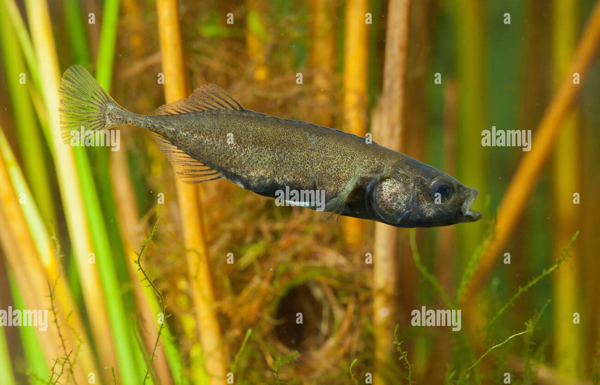
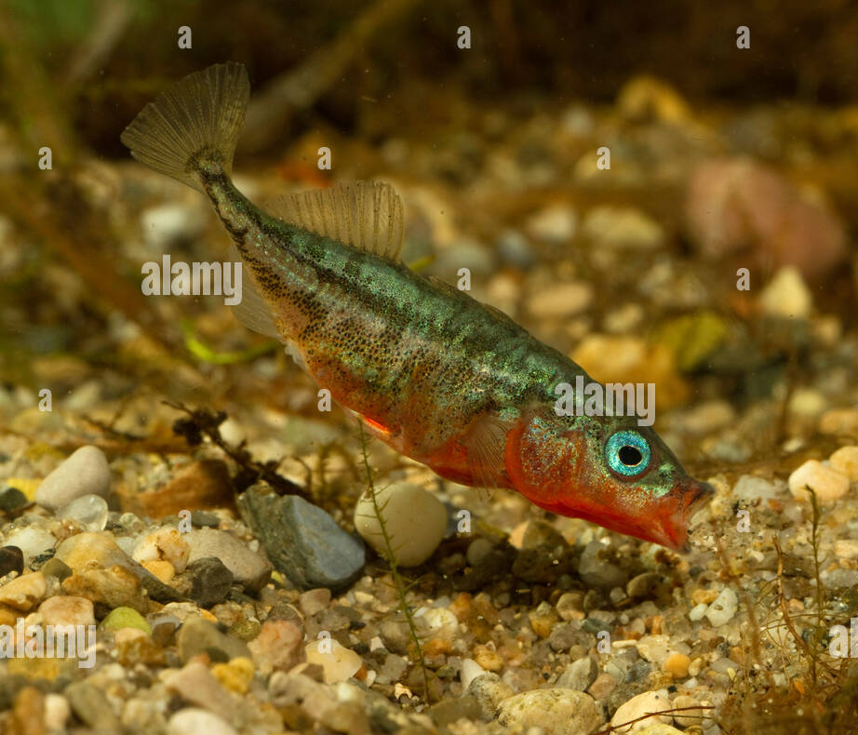
Species typical behaviour patterns
Releaser
Fixed action pattern : behaviour released by such a stimulus
E.g. Stickleback fish – given the stimulus, the behaviour will follow
May seem limiting from the human perspective, but for the animals it is adaptive

Slide 5
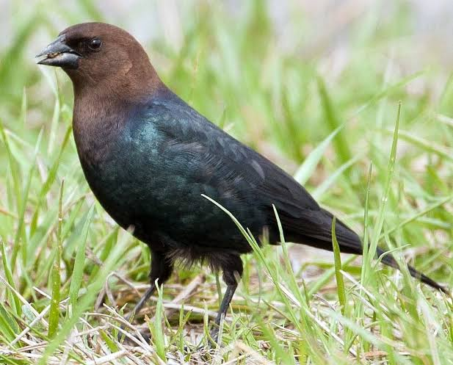
Species typical behaviour among cowbirds
Promotes finding mates in own species to improve chances of species survival
A cowbird

Slide 6
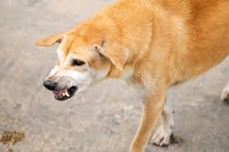
Survival can be promoted by warning/threatening
Species typical behaviour can also be in form of aggression – dogs- curling lips and barring teeth to show threat

Slide 7
Species typical behaviour patterns
Emotional expression is mostly same in all members of a particular species
Crucial for social interactions of species members
Among humans it provides signals about other animal’s or person’s emotional state and consequently behaviour that may be forthcoming

Slide 8
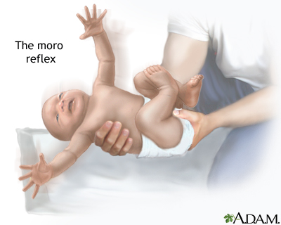
Species typical behaviour among Humans
More complex than lower animals – due to the flexibility of behaviour
Human evolution – lead to – behaviour strongly influenced by learning – through events that take place in life
Fixed action behaviours – prominent in lower animals not so prominent in human nature
Infants reflexes- grope, swallow, breathing, blinking, coughing, sneezing, and withdrawing from painful stimuli
Moro reflex: when support is suddenly removed from behind the head, the neonate flings arms to the side, extend its fingers and bring arms inward in a sort of embracing movement

Slide 9
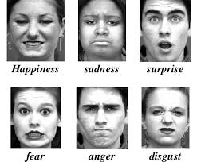
Expression of certain emotions are species typical behaviours in humans
While not prominent, we do have some species specific behaviours as part of our animal natures.

Slide 10
Evolutionary heritage leading to behaviours in Humans
Evolution effects at a deeper and fundamental level – predisposes us to act or exhibit certain behaviours as opposed to others.
More probable or less probable
Built-in programmed biases towards certain types of behaviour– e.g altruism – the lookout calling attention to themselves so that others can run away
more genes of altruism are ultimately persevered than removed from the death of one single altruistic individual – making groups more adapted to survival- thus altruistic gene gets selected and becomes part of the species gene pool/ heritage.
Certain behaviours are learned – produce and understand language – no matter which language we speak
These are broad tendencies – not specific behaviours (which are based on individual experiences- choosing to follow a career after exposure to adverse conditions)

Slide 11
Books
Atkinson., Hilgard., Nolen-Hoeksema, S., Fredrickson, B., Loftus, G. and Lutz, C. (2014). Introduction to psychology. Hampshire, United Kingdom: Cengage Learning EMEA.
Morgan, Clifford T. & King, Richard A. (2017). Introduction to psychology. New York: McGraw-Hill
Saundra K. Ciccarelli, Girishwar Misra, J. Noland White. Psychology (5e). Pearson Education India

Slide 12
Tendencies towards competition and aggression- especially in males is innate
Territoriality, need for organization with leaders, certain child rearing behaviours, male female roles – a thought to be innate behavioural potentialities- having a basis in evolution
This is controversial- though anthropological evidence of stone age cultures support innate basis of behavioural tendencies- e.g. aggression- other evidences do not.
Evidence for nurture- elder Eskimos choosing to stay behind and die rather than slowing the whole group, search and rescue parties looking for lost persons even under dire circumstances.
Evolutionary heritage leading to behaviours in Humans- is it always true?

Slide 13
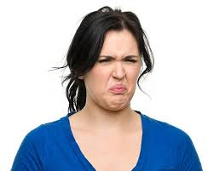
Nature vs. Nurture
In the absence of conclusive evidence the debate about innate vs environmental infuences on human behaviour continues.
Psychologists emphasise both – genes and structures as well as unique life circumstances that undermine human nature
One way to look at biological and evolutionary basis of behaviour- Ernst Mayr (1960) – many evolutionary “novelties” result due to co-opting existing systems for new functions
The voicing system- teeth, tongue, mouth initial purpose – eating – evolved to produce sounds and later the pronunciation of language (Atkinson & Hilgard, 2014)
Similarly, the disgust response described by Darwin- the gape, tongue extension, nose wrinkle and dropping of the mouth corners developed as response to preventing food from going inside the mouth or encourage its discharge. Disgust response is associate with the brain’s right prefrontal area and basal ganglia. Rozdin et al. (2000) propose what was to avoid harm to the body evolved to avoid harm to the soul- against morally disgusting. But learning what is morally disgusting is part of socialization in cultures.
Look at the structures of the brain and the nervous system: CASE
Facial expression of disgust

Slide 14
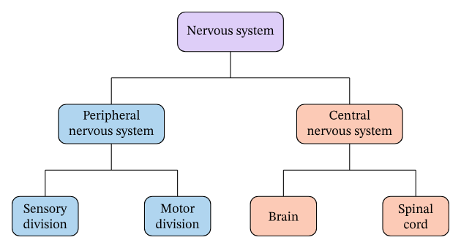
Organization of the Nervous System
All neural tissue
Remaining neural tissue in the rest of the body- transmits info. to and from the CNS
Carries messages to and from the sense receptors, muscles (for conscious and voluntary motor functions
Connects the internal organs and glands (for autonomic and involuntary functions)
The part that resides inside the skull- interprets and stores info.
Connects brain and PNS

Slide 15
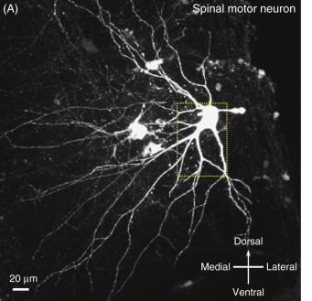
In the Somatic System/ Sensory division
Sensory nerves:
Transmit information about the external stimulation from the skin, muscles, and joints to the CNS
We become aware of pain, pressure, temperature variations
Motor nerves:
Carry impulses from the CNS to the muscles, where they initiate action
Control all muscles we use in voluntary movements as well as involuntary adjustments in posture and balance
Mentis (2013)

Slide 16
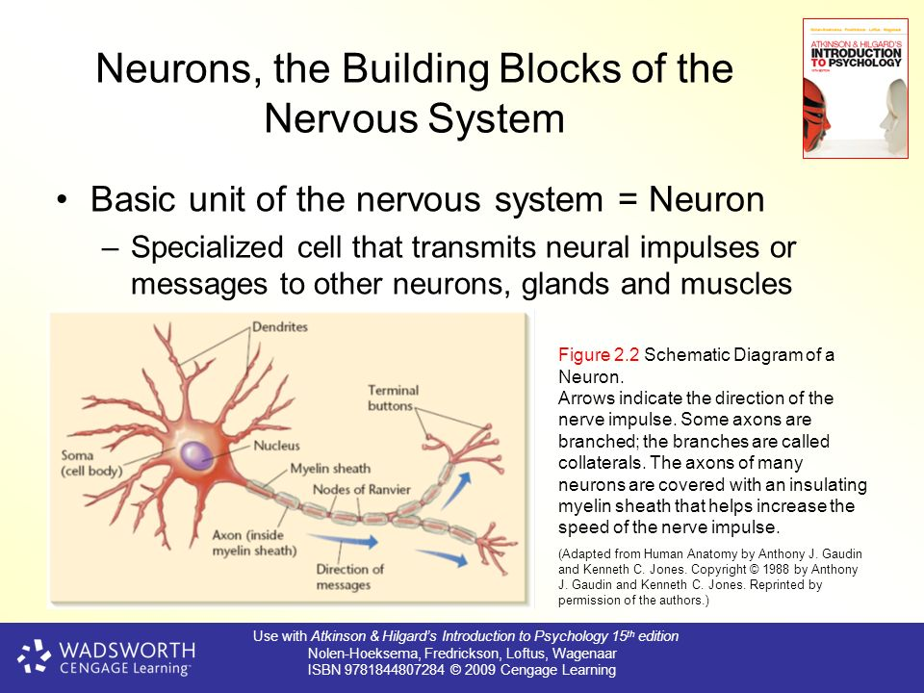

Slide 17
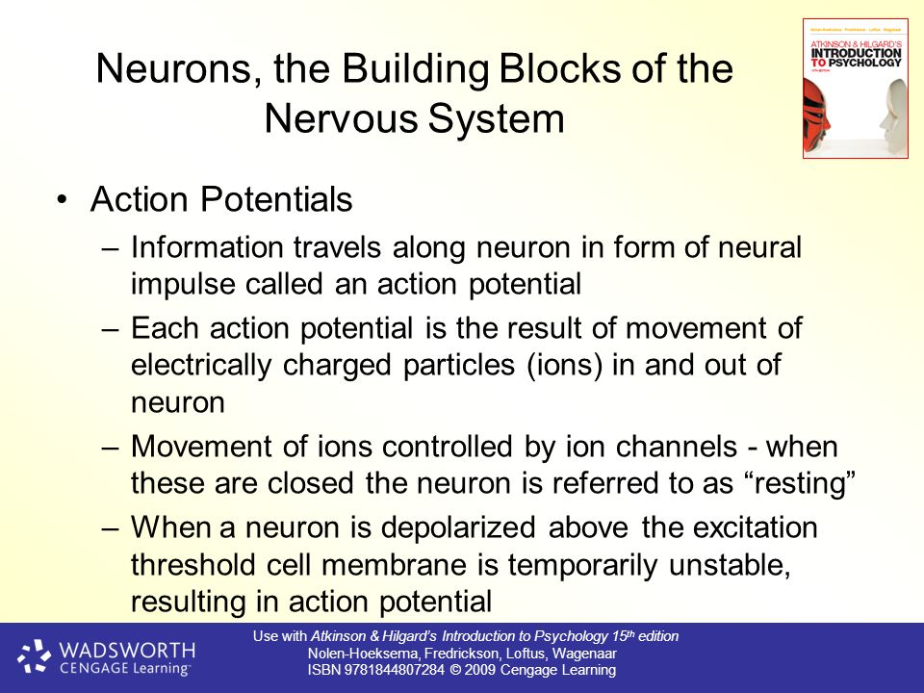

Slide 18
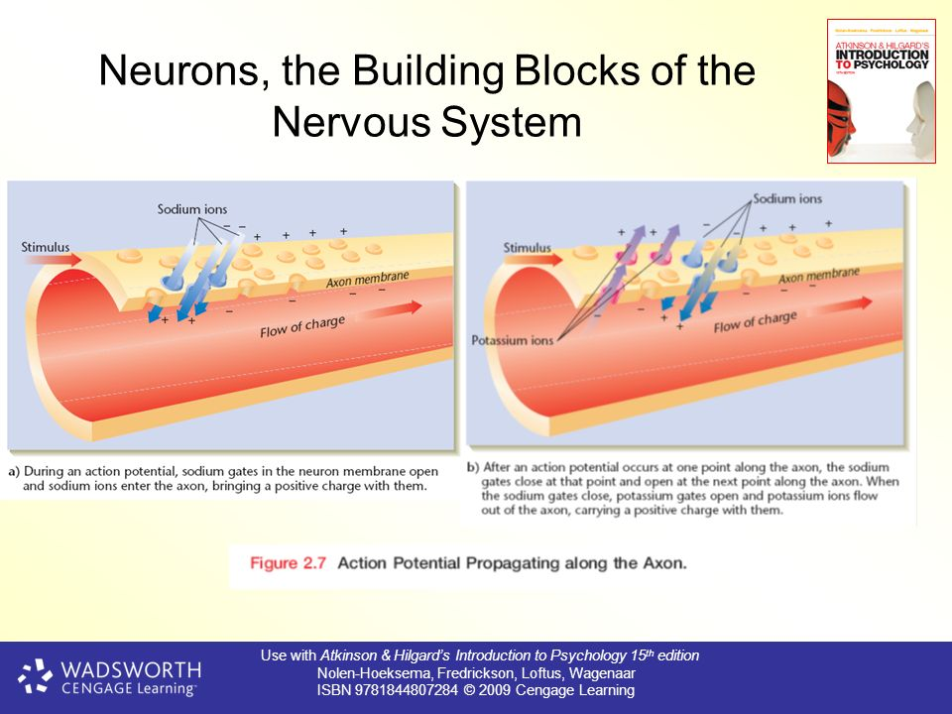
Resting potential: -70millivolts
Excitation threshold: -55 mV
Inside goes up to +40 mV

Slide 19
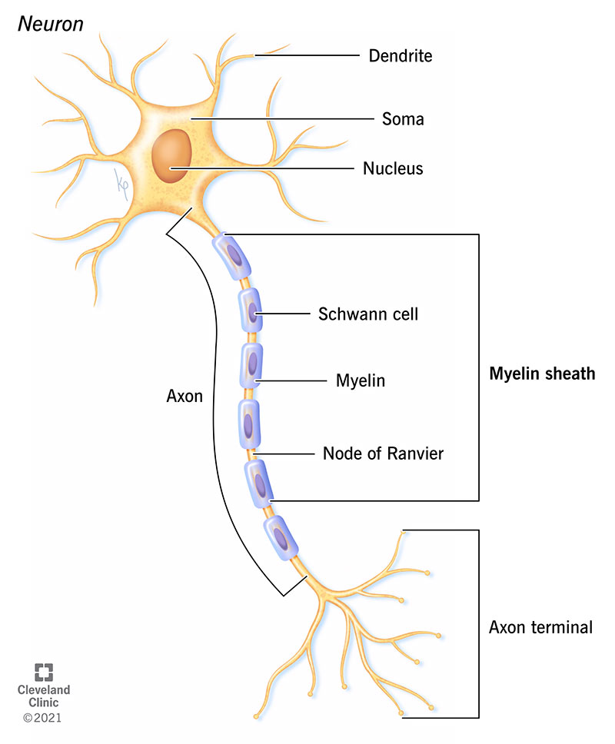
Why does the action potential travel in only one direction?- due to a refractory period- after it had generated a “spike” the membrane cannot do so again for about a millisecond.
Speed: 1- 120 meters/ second – affected by cover of myelin sheath
The myelin sheath is particularly prevalent where rapid transmission of the action potential is critical- e.g. – long axons that stimulate skeletal muscles
In multiple sclerosis , a disorder in which symptoms first become evident between the ages of 16-30, the immune system attacks and destroys body’s own myelin sheaths, - resulting – in severe motor nerve dysfunction

Slide 20
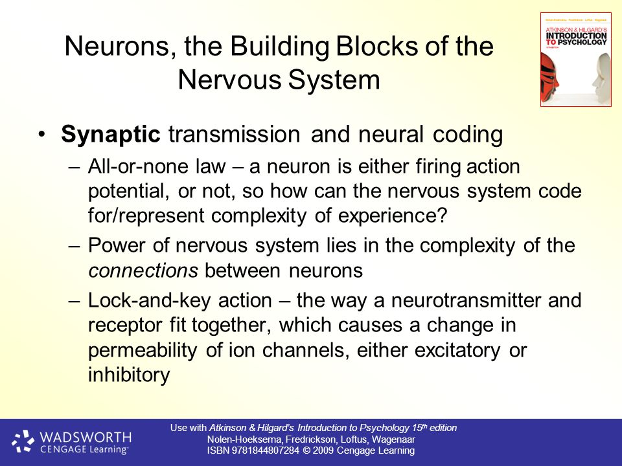

Slide 21
Another way- involving a greater population of neurons in the response
Population coding can be powerful- synchronization (or lack of it) in response to the individual neurons often contains meaning as well.
What becomes important therefore is the connections between the individual neurons.

Slide 22
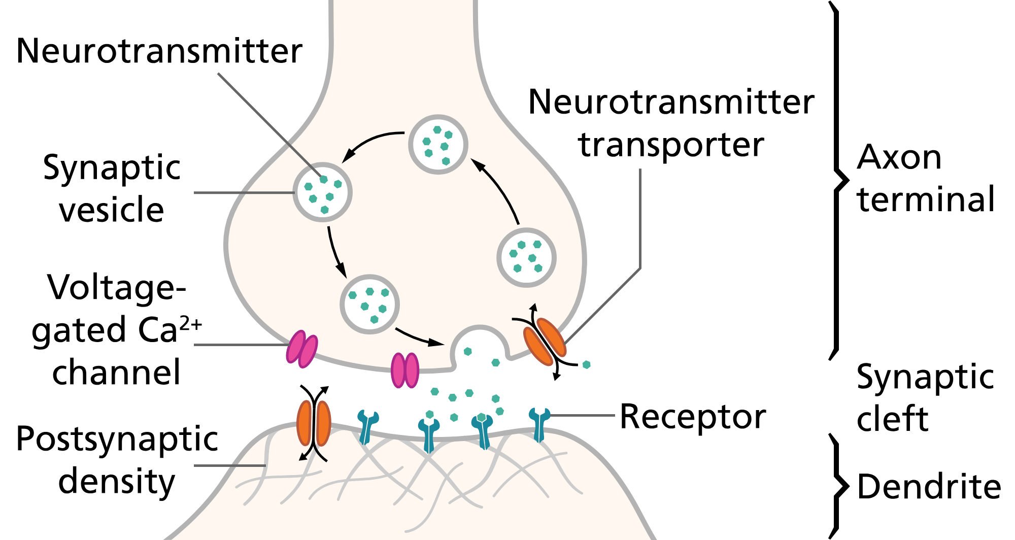
Synaptic Transmission
Action must be brief to maintain precise control
Reuptake
Degradation

Slide 23
2 types of effects
Excitatory effect: allows positively charged ions (such as Na+) to enter the post synaptic neuron – resulting in depolarization of the neuron.
-This makes the post synaptic neuron more likely to reach its excitatory threshold and thus more likely to generate an action potential.
Inhibitory effect: positively charged ions (K+) leave the neuron or a negatively charged ions (Cl-)enter – making the inside more negatively charged than before.
- Consequently less likely to reach the excitatory threshold and therefore less likely to generate an action potential

Slide 24
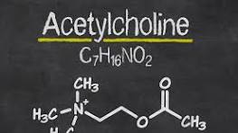
Neurotransmitters : Acetylcholine
Present at many synapses throughout the nervous system
Usually excitatory, sometime inhibitory – depending on the type of receptor molecule in the membrane of the receiving neuron.
High concentration: Forebrain- hippocampus – plays a key role in the formation of new memories (Eichenbaum, 2000).
Related to Alzheimer's disease- a memory disorder. – neurons in the forebrain that produce acetylcholine degenerate in Alzheimer’s patients.
The less acetylcholine is produced the more is the memory loss.

Slide 25
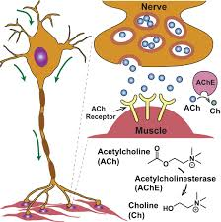
Acetylcholine
Released at every synapse between a motor neuron and a skeletal muscle fibre- causing muscle contraction
Drugs can affect acetylcholine and produce muscle paralysis
Botulinum toxin: bacteria from improperly canned foods blocks release of acetylcholine and causes death by paralysis then muscles used in breathing
Nerve gases and many pesticides: cause paralysis by destroying the engyme that degrade acetylcholine- causing uncontrolled buidup and normal synaptic transmission is impossible

Slide 26
Norepinephrine
Noradrenaline
Produced by neuron of the brain stem
Alertness and arousal
Any drug that causes an increase or decrease in this neurotransmitter is correlated with increase or decrease in the individual’s mood level
Cocaine and amphetamines prolong the action norepinephrine by slowing its reuptake – receiving neurons activated for a longer time
Lithium speeds up reuptake – causing mood to be depressed

Slide 27
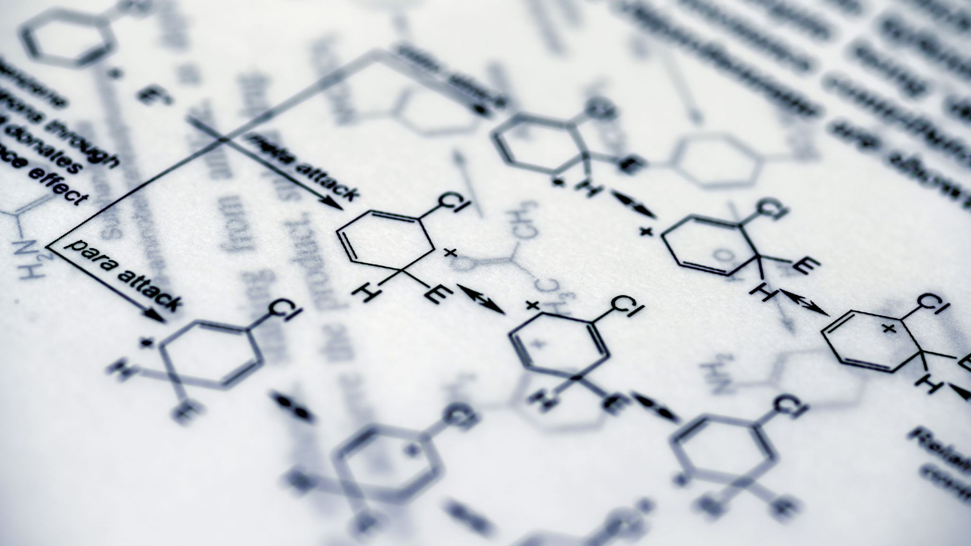
Dopamine
Chemically similar to norepinephrine
Regulates motivation and emotional pleasure (e.g. food and sex; goal attainment)
Regulates incentive salience (Schultz, 2002) – how much we want something : e.g. food (Volko et al., 2012)
Too much dopamine in some parts of the brain may cause schizophrenia (drug: clozapine or chlorpromazine)
Too little in other parts causes- Parkinson’s disease (L-dopa)

Slide 28

Serotonin
Mood regulation
Low levels: feeling depression
Serotonin reuptake inhibitors are used as anti depressants that increase serotonin n the brain by blocking its uptake. (Prozac, Zoloft, Paxil)
Important in regulation of sleep and appetite – used to treat eating disorder of bulimia
Lysergic acid dietylamide (LSD) induces the effects of serotonin by binding to its receptors in the brain

Slide 29

GABA
Gamma-aminobutyric acid
Major inhibitory transmitter
Most synapses in the brain use GABA
Blocking of GABA receptors produces convolutions as muscle movements cannot be controlled without GABA’s inhibitory influence.
Tranquilizing effects od certain anti-anxiety drugs (benzodiazepines) are a result of GABA’s inhibitory actions

Slide 30
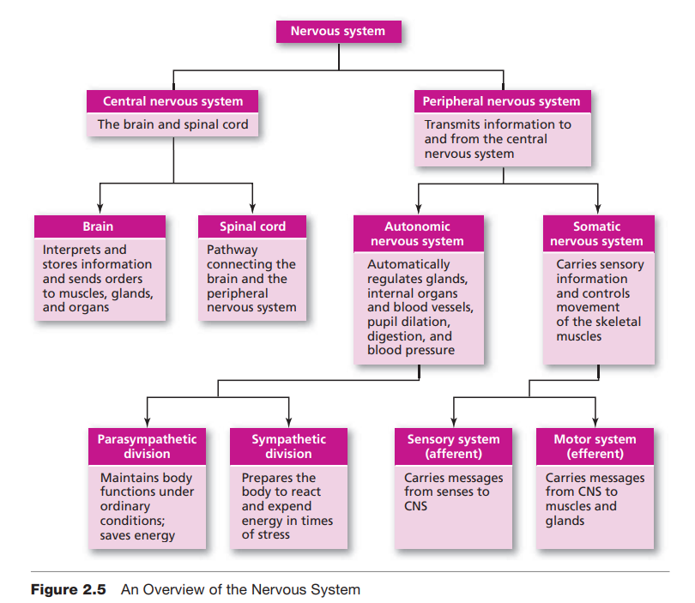

Slide 31
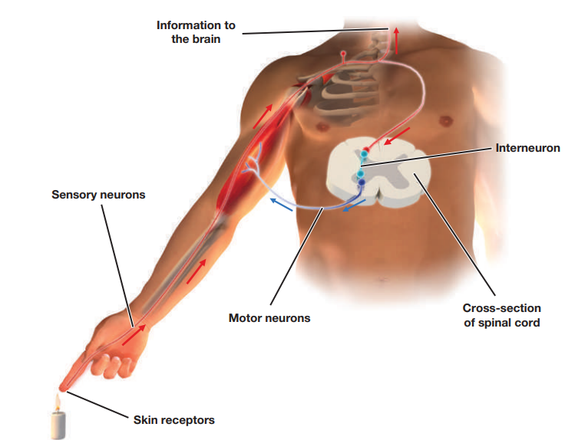
The Spinal Cord
Long bundle of neurons that serves two vital functions.
Outer section is composed mainly of myelinated axons and nerves, which appear white, whereas the inner section is mainly composed of cell bodies of neurons, which appear gray.
The purpose of the outer section is to carry messages from the body up to the brain and from the brain down to the body. It is simply a message “pipeline.”
2. Reflexive action: Fast response time – Reflex arc
The inside section, which is made up of cell bodies separated by glial cells, is actually a primitive sort of “brain.”
This part of the spinal cord is responsible for certain reflexes— very fast, lifesaving reflexes.
Touch a flame or a hot stove with your finger, for example, and an afferent neuron will send the pain message up to the spinal column, where it enters into the central area of the spinal cord. The interneuron in that central area will then receive the message and send out a response along an efferent neuron, causing your finger to pull back. This all happens very quickly.

Slide 32
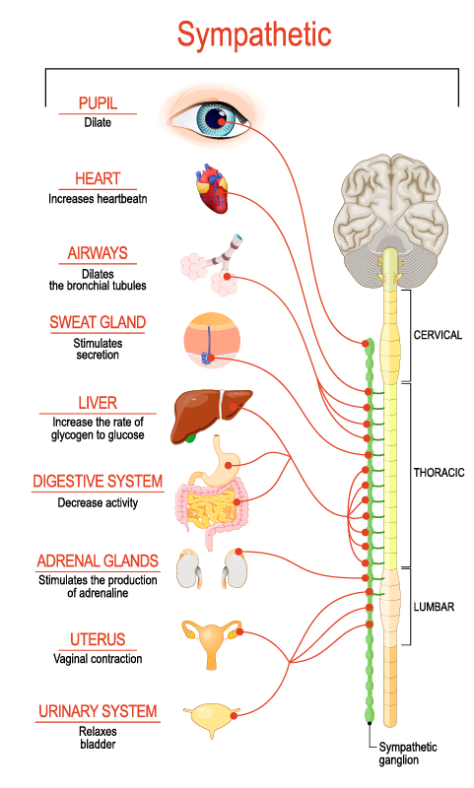
The Sympathetic Division
Located on the middle of the spinal column —running from near the top of the ribcage to the waist area.
Usually called the “fight-or-flight system” (sympathy with one’s emotions?)
Get the body ready to deal with stress- anger or joy , fear
Pupils get bigger
Heart starts pumping faster, drawing blood away from non-essential organs (skin) sometimes brains (fainting)
Lungs work faster, increase blood oxygen (Heavy breathing)
Adrenal glands: release stress related hormones (adrenaline, cortisol – heart, lungs, and muscles)
Not every organ stimulated- digestion, excretion, saliva dries up – really scared the bowels or bladder empty
Burn blood sugar
Stress ends- activation of parasympathetic division.
Stress for too long- person collapses – as PNS division overreacts in trying to inhibit SNS- heart slows, blood vessels open up, blood pressure in the brain drops- resulting in fainting.

Slide 33
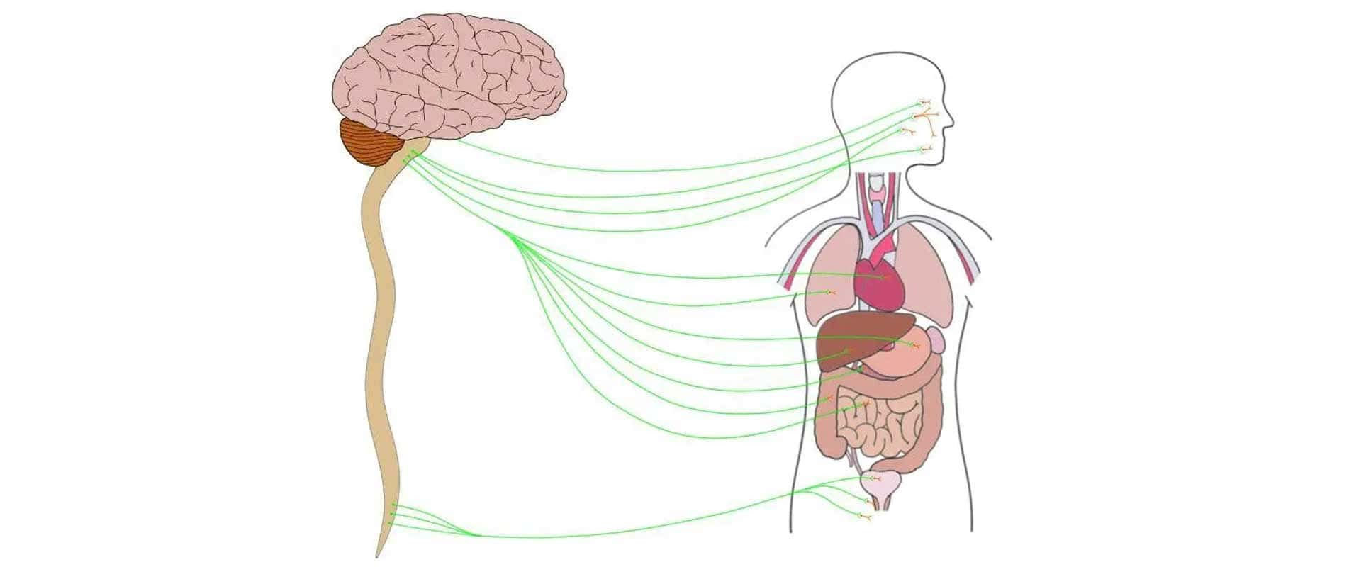
The Parasympathetic Division
“eat-drink-and-rest” system
Para = beyond or next; refers to neurons located on either side of the sympathetic division neurons
Location; top and bottom of the spinal cord
Two different functions:
Brings body down to rest or normal functioning after a fight and flight response –
Slows heart rate and breathing
Constricts pupils
Reactivated digestion and excretion
Signals to the adrenal glands to stop (PNS not connected to adrenal glands)
Restores energy that was burned – making people hungry after stress is over
Responsible for most ordinary everyday functioning- regular heartbeat, normal breathing, and digestion
At any given time- SNS or PNS determine if individuals are aroused or relaxed

Slide 34
REGENERATION AND REPAIR OF NERVOUS TISSUE
Earlier: neurons don’t repair
E.g. Recovery from stroke- due to healthy brain cells taking over the functions of damaged cells.
Throughout your life, your nervous system exhibits plasticity, the capability to change based on experience.
Brain: neuroplasticity- ability to constantly change both the structure as well as function of many cells in the brain in response to trauma or experience (Neville & Bavelier, 2000)
At the biological level: At the level of individual neurons, the changes that can occur include the sprouting of new dendrites, synthesis of new proteins, and changes in synaptic contacts with other neurons (Sanes & Jessel, 2013).
Neurogenesis: Brain can change through this process. Formation of new neurons and important process during the development of our nervous system.
Mostly prior to birth – during prenatal period
Regeneration : still limited in mammals - mostly hippocampus
Physical exercise benefits neurogenesis and neuroplasticity (Prakash, 2015)
Good sleep is important (Tesler, 2016)
Stem cell transplantation – research ongoing (Huang et al, 2015)

Slide 35
Case: Phineas Gage

Slide 36
Principles of Learning
Learning: Learning may be defined as a relatively permanent change in behaviour that occurs as the result of prior experience. (Atkinson & Hilgard, 2019)
“Relatively permanent”: when people learn anything, some part of the brain is changed to record this (Farmer et al. 2013)
Process of memory- without the ability to remember what happens learning cannot take place.
“experience or practice”: e.g. last time you experienced pain- we learn. Vice versa for pleasure experience.
Not all change is accomplished through learning
Maturation: height, size of the brain, practice alone will not allow a child to walk. – genetic blueprint

Slide 37
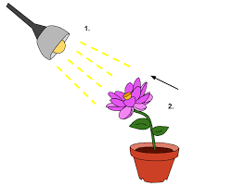
Classical conditioning
A learning process in which a previously neutral stimulus becomes associated with another stimulus through repeated pairing with that stimulus.
Salivary glands automatically start releasing saliva to help with chewing and digestion- normal reflex—an unlearned, involuntary response that is not under personal control or choice—one of many that occur in both animals and humans.
The food causes a particular reaction, the salivation.
A stimulus can be defined as any object, event, or experience that causes a response, the reaction of an organism.
In the case of Pavlov’s dogs, the food is the stimulus and salivation is the response.

Slide 38
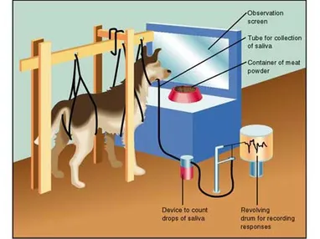
Pavlov’s Classical Conditioning/ Respondent Conditioning
Apparatus used by Ivan Pavlov

Slide 39
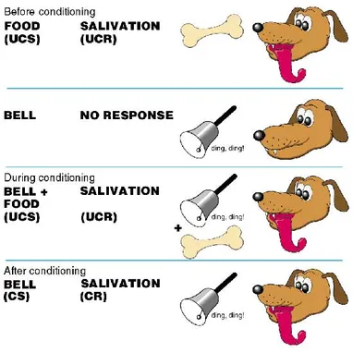
Unconditioned stimulus ( = unlearned) : (UCS) stimulus consistently evoke a response, often involuntary in nature, or is reliably followed by one,– e.g. food
Conditioned Stimulus: (CS) – neutral initially- has only a function of alerting, or attentional the first few times – e.g. bell
Unconditioned response: response following the UCS
UCR
CR

Slide 40
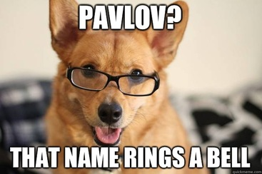
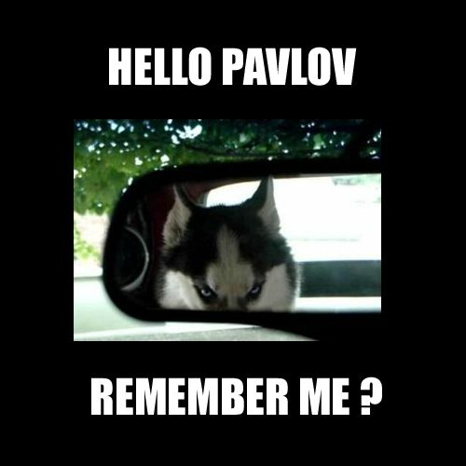

Slide 41
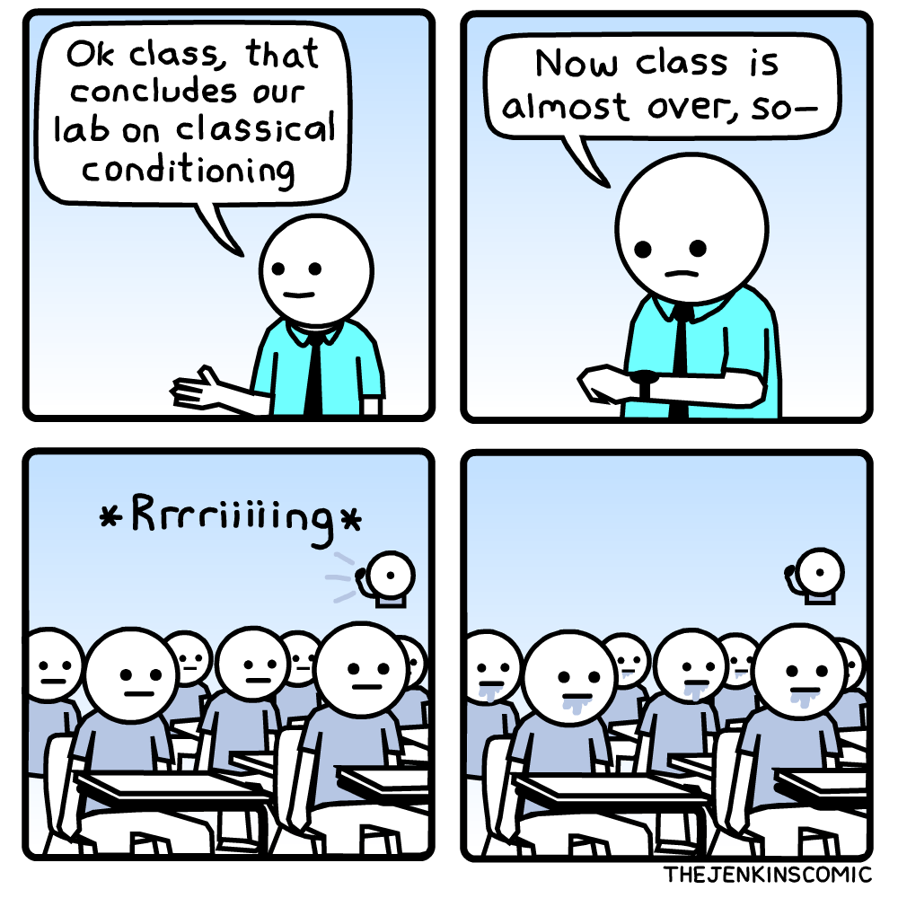
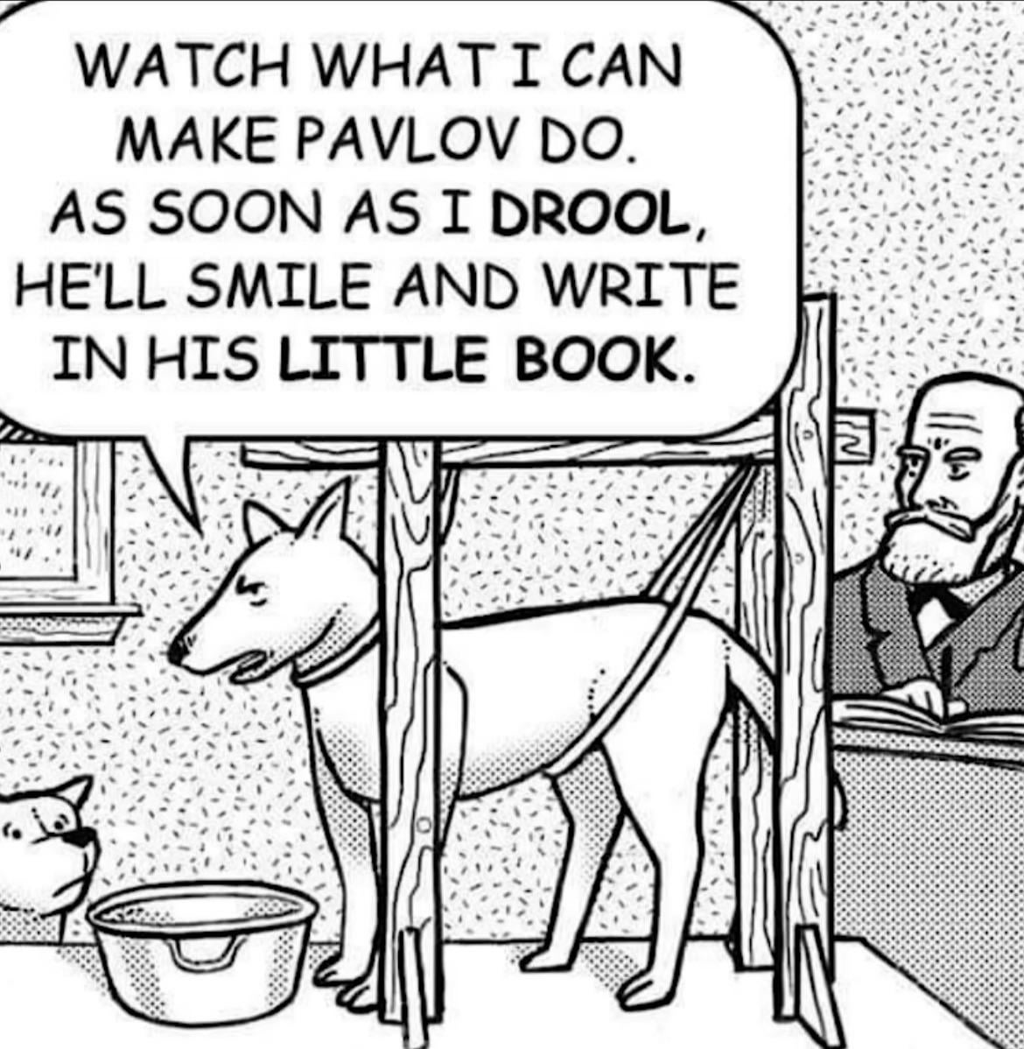

Slide 42
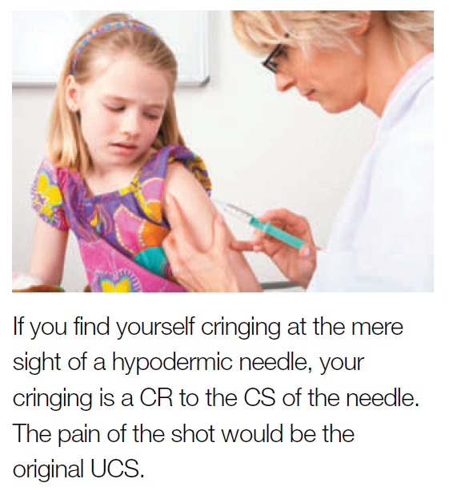
Everyday occurrences using Classical Conditioning
Does your mouth water when you merely see an advertisement for your favorite food on television?
Do you feel anxious every time you hear the high-pitched whine of the dentist’s drill?
The familiar ping of a notification can make your heart pump with excitement, or it could induce stress.
Neutral Stimulus: Notification Sound
Unconditioned Response: No emotional reaction
Natural Stimulus: Something that triggers an emotional response
Natural Response: Emotional Response (stress or excitement)
Conditioned Stimulus: Notification Sound
Conditioned Response: Emotional Response (stress or excitement)

Slide 43
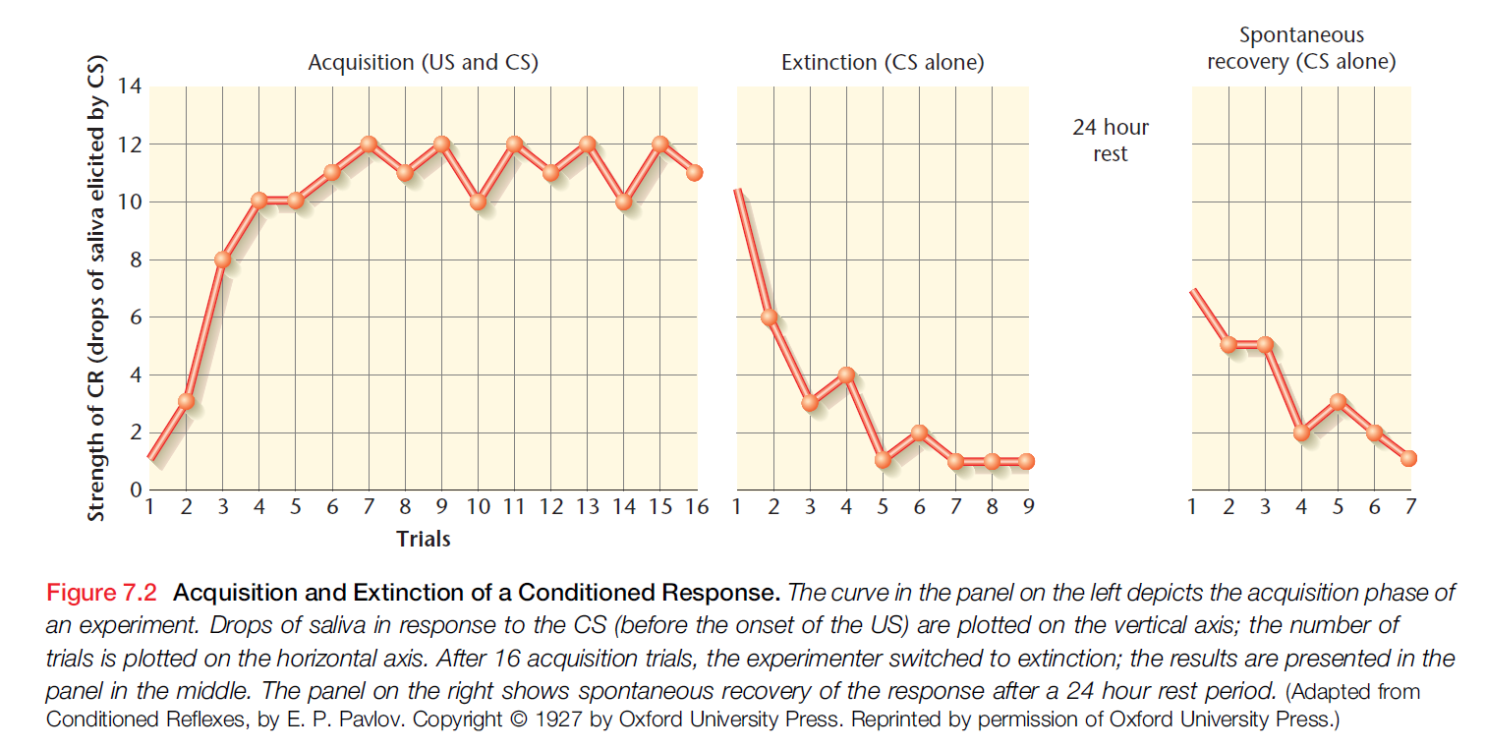

Slide 44

Few basic principles about the process
1. The CS must come before the UCS. If Pavlov sounded the metronome just after he gave the dogs the food, they did not become conditioned (Rescorla, 1988).
2. The CS and UCS must come very close together in time—ideally, no more than 5 seconds apart. When Pavlov tried to stretch the time between the potential CS and the UCS to several minutes, no association or link between the two was made. Too much could happen in the longer interval of time to interfere with conditioning (Pavlov, 1926; Ward et al., 2012; Wasserman & Miller, 1997).
3. The neutral stimulus must be paired with the UCS several times, often many times, before conditioning can take place (Pavlov, 1926).
4. The CS is usually some stimulus that is distinctive* or stands out from other competing stimuli. The metronome, for example, was a sound that was not normally present in the laboratory and, therefore, distinct (Pavlov, 1927; Rescorla, 1988).

Slide 45
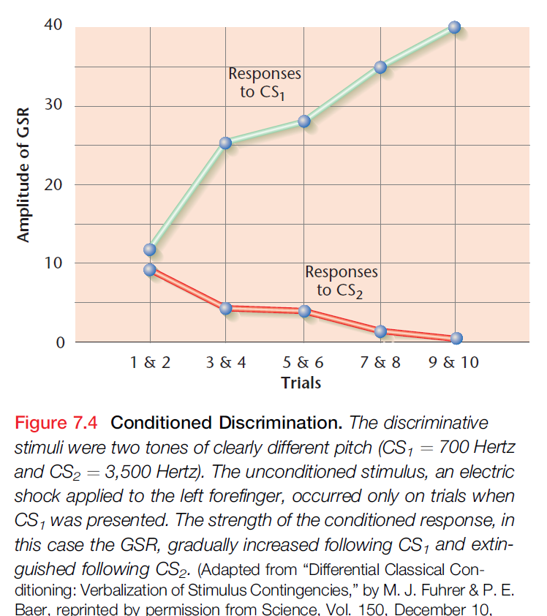
Stimulus generalization
dogs that had been trained to have a conditioned response to a certain tone, would show the same response to a tone that was slightly higher or lower in pitch.
Response generalization: the more similar the new stimuli are to the original CS, the more likely they are to evoke the same response.
Accounts in part for a human or animal’s ability to react to novel stimuli that are similar to familiar ones – an ability that is clearly adaptive
Stimulus Discrimination and Differential conditioning: another possible consequence of classical conditioning is a decrease in the probability or magnitude of a behavioral response – this is inhibitory conditioning.

Slide 46
Biological constraints
Early behaviorists assumed that the laws of learning were the same for all species. Moreover, they assumed that any CS could be associated with any US through classical conditioning.
Early behaviourists firmly on the nurture side of the nature–nurture debate: what an organism learns, depends entirely on its experiences with the environment. – Babbling behaviour (Watson, 1913).
Konrad Lorentz, Nikolaas Tinbergen, and Karl von Frisch made discoveries that revealed powerful biological predispositions in human and animal behavior (Tinbergen, 1951)

Slide 47
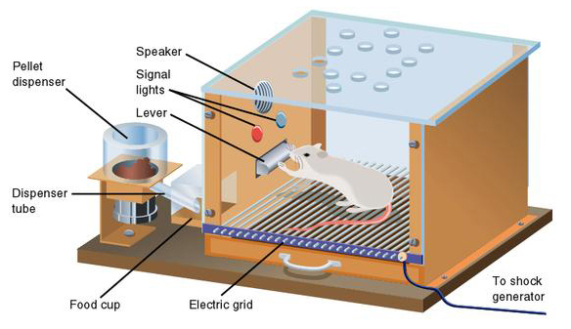
Skinner’s Operant Chamber
When a food-deprived rat is placed in the box, its behavior at first is spontaneous and random. The rat is active, sniffing, poking, and exploring its environment. These behaviors are emitted, not elicited; in other words, the rat is not responding to any specific stimulus in its environment.
At some time during this activity, the rat will depress a lever or bar located on one wall of the Skinner box, causing a food pellet to drop into a trough.
The food is a reinforcer for the behavior of depressing the bar.

Slide 48
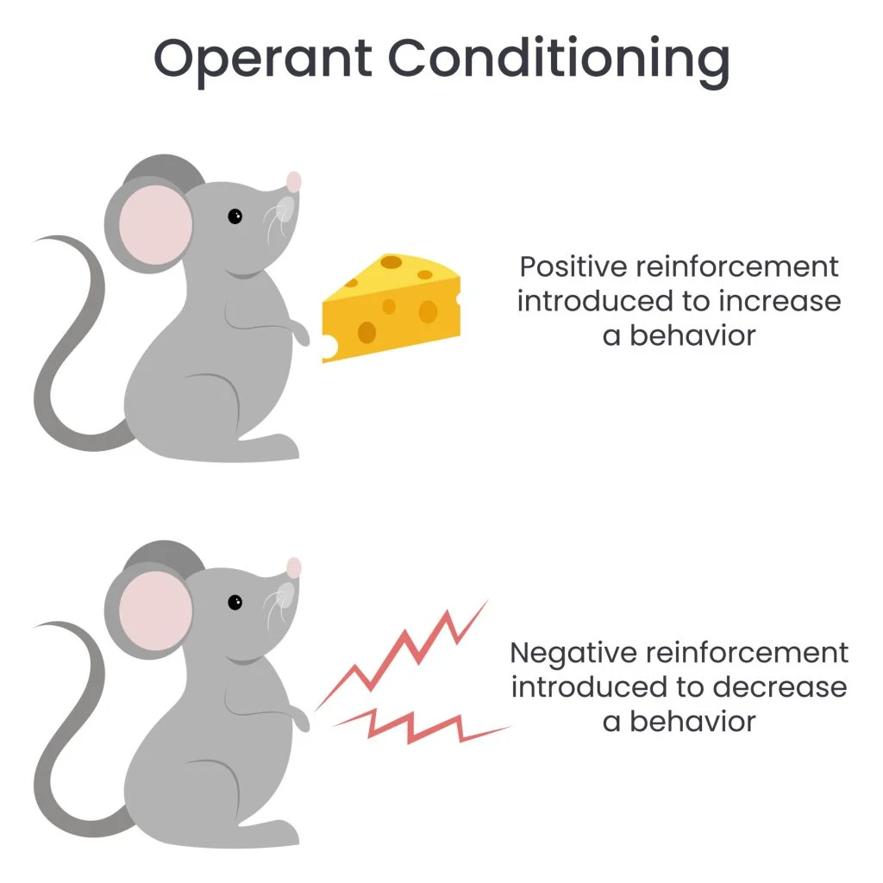
OPERANT CONDITIONING
Or Instrumental conditioning: instrumental – as learning some action ( or behaviour) is instrumental in bringing about a change in the environment that makes the action (or behaviour) more or less likely to occur again in future
E.g. getting a reward
Reinforcer: An environmental event that is the consequence of an instrumental response and that makes that response more likely to occur again- increases the likelihood that behaviour will occur again
Positive reinforcer: Stimulus or event which when it follows a response increases the likelihood that the response will be made again – bar pressing is followed by food
the reinforcer has to be contingent upon the instrumental response

Slide 49
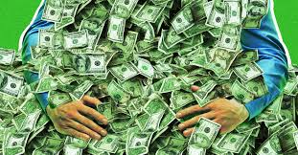
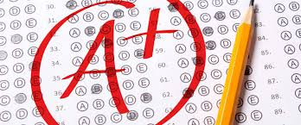
Reinforcers
The response results in the occurrence of the reinforcer – that is responses that pay off – are repeated
E.g. food, water, praise, prize – when contingent on behaviour
Primary reinforcers are stimuli that are naturally reinforcing because they are not learned and directly satisfy a need, such as food or water.
Secondary reinforcers are stimuli that are reinforced through their association with a primary reinforcer, such as money, school grades. They do not directly satisfy an innate need but may be the means. So a secondary reinforcer can be just as powerful a motivator as a primary reinforcer.

Slide 50
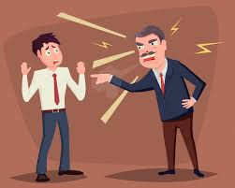
Negative reinforcer
Punishment
A stimulus or event which, when its cessation or termination is contingent on a response, increases the likelihood that the response you want them to learn will occur again
The word negative (-ve) refers to the fact that the response causes the termination of the event
E.g. bar pressing terminates or prevents shock, bawling by the boss will stop on doing good work
Response tend to become
more likely
A stimulus or event whose onset is contingent on a response and thereby decreases the likelihood that the response will occur again
E.g. the boss shouting if the job is not done well, Traffic fines, demerits, beatings – when contingent on behaviour ending,
Responses followed by punishment do not tend to be repeated

Slide 51
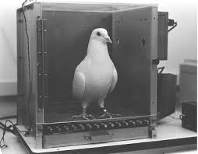
Successive Approximation: The Shaping of Behavior
Animals and humans demonstrate many more complex operant behaviors that have a much lower probability of occurrence in the normal course of events.
How are these complex behaviors learned?
How can an experimenter or a parent reinforce and condition a pigeon or a child to perform behaviors that are not likely to occur spontaneously?
The pigeon was reinforced with food when it merely turned toward the designated spot.
Then reinforcement was withheld until the pigeon made some movement, however slight, toward the spot.
Reinforcement was given only for movements that brought the pigeon closer to the spot.
After that, the pigeon was reinforced only when it thrust its head toward the spot. Finally, the pigeon was reinforced only when its beak touched the spot.
Although this sounds like a time-consuming process, Skinner conditioned pigeons in fewer than 3 minutes.
Skinners explanation of language acquisition in children.
New use: Pigeon collecting waste

Slide 52

Skinner believed that most human and animal behavior is learned through operant conditioning.
E.g. learning among babies - An infant initially displays random, spontaneous behaviors, only some of which are reinforced (rewarded with food or hugs or toys, for example) by parents, siblings, or caregivers. As the infant grows, the positively reinforced behaviors, those of which the parents approve, will persist, whereas those of which the parents disapprove will be extinguished or discontinued. The concept is the same with the rat in the Skinner box.

Slide 53
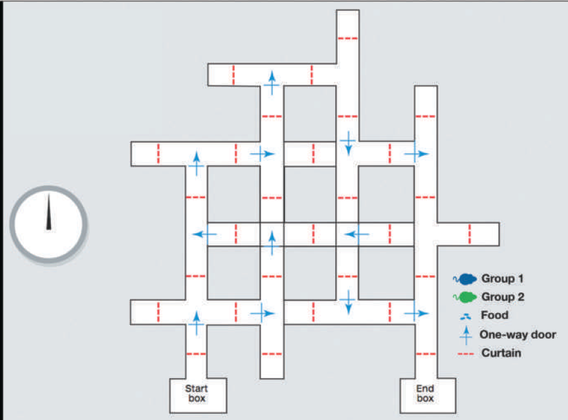
Cognitive Learning Theory
Tolman’s Maze-Running Rats : Latent Learning
Teaching three groups of rats the same maze, one at a time (Tolman & Honzik, 1930).
Group 1 : each rat was placed in the maze and reinforced with food for making its way out the other side. The rat was then placed back in the maze, reinforced upon completing the maze again, and so on until the rat could successfully solve the maze with no errors
Group 2: The second group of rats never received any reinforcement upon exiting the maze. Put back in again and again, until the 10th day of the experiment- reinforcement given
Group 3: control group, was also not reinforced and was not given reinforcement for the entire duration of the experiment

Slide 54
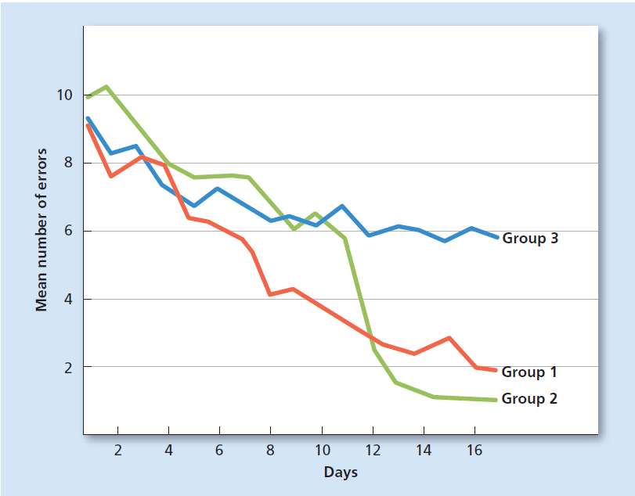
The second group of rats, should have then taken as long as the first group to solve the maze. Instead, they solved the maze almost immediately
The rats had learned where all the blind alleys, wrong turns, and correct paths were and stored this knowledge away as a kind of “mental map,” or cognitive map of the physical layout of the maze.
Cognitive map – a mental understanding of an environment, formed through trial and error as well as observation. The concept is based on the assumption that an individual seeks and collects contextual clues, such as environmental relationships, rather than acting as a passive receptor of information needed to achieve a goal. (APA, 2018)
Rats in the second group had learned and stored that learning away mentally but had not demonstrated this learning because there was no reason to do so.
Latent learning: learning that is acquired without conscious effort, awareness, intention, or reinforcement and is not manifested as a change in performance until a specific need for it arises. (APA, 2018)

Slide 55
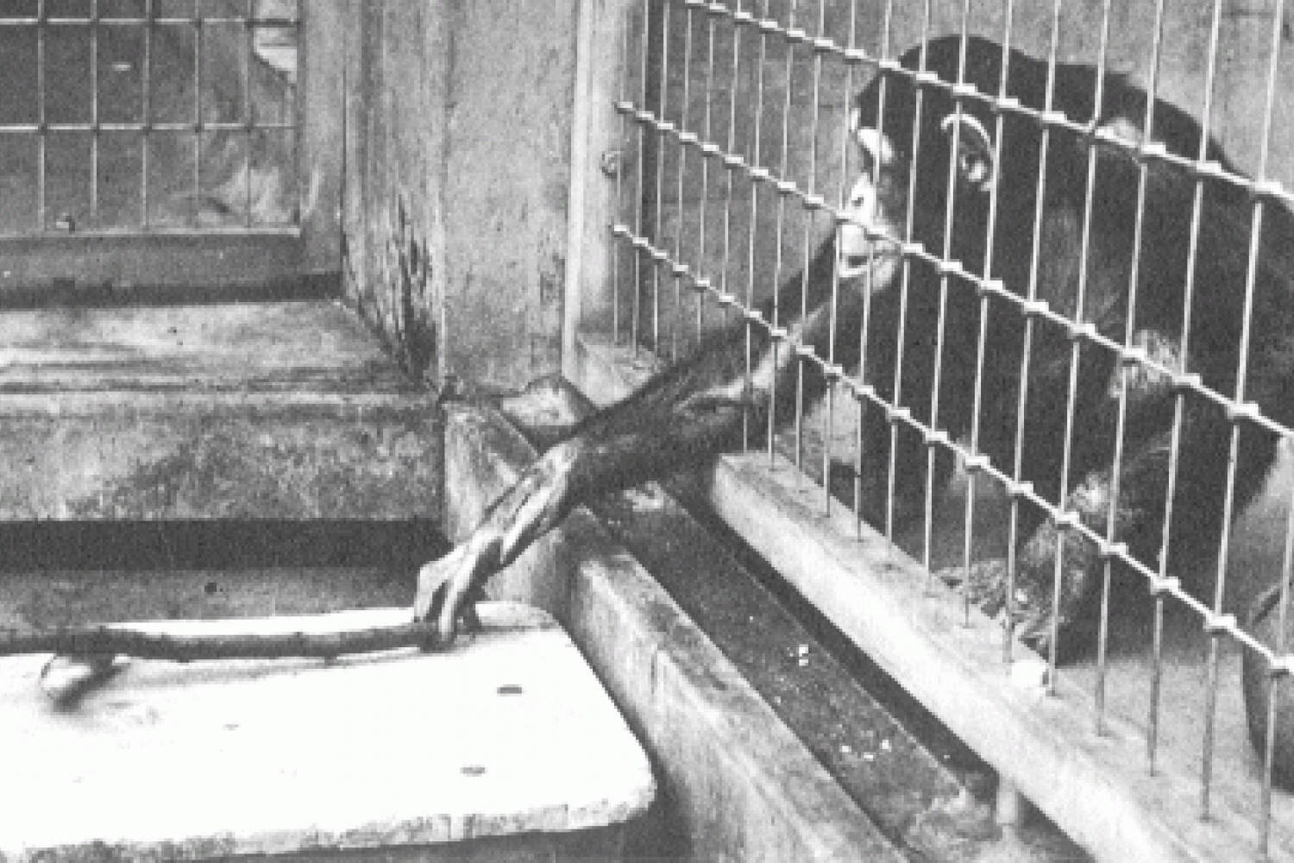
Kholer’s Insight Theory
(Köhler, 1925), he set up a problem for one of the chimpanzees.
Sultan the chimp was faced with the problem of how to get to a banana that was placed just out of his reach outside his cage.

Slide 56
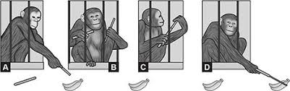
Kholer’s Insight Theory
Köhler called Sultan’s rapid “perception of relationships” insight and determined that insight could not be gained through trial-and-error learning alone (Köhler, 1925).
Insight requires a sudden
“coming together” of all the elements
of a problem in a kind of “aha” moment that is not predicted by traditional animal learning studies.
149162536496481100…
Perceptual reorganization of elements in the environment such that new relationships between objects are suddenly seen

Slide 57
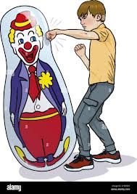
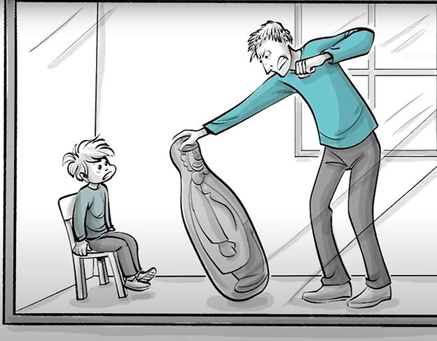
Observational Learning: “monkey see, monkey do.”
Learning of new behavior through watching the actions of a model (someone else who is doing that behavior) – form of latent learning.
Imitation behaviour: a response that is like the stimulus that triggered it
Sometimes that behavior is desirable, and sometimes it is not
Bandura’s Bobo Doll experiment (1961)
Ah, but would that child have imitated the model if the model had been punished? Wouldn’t the consequences of the model’s behavior make a difference?

Slide 58
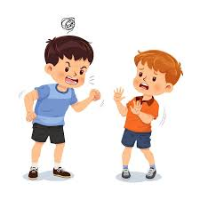
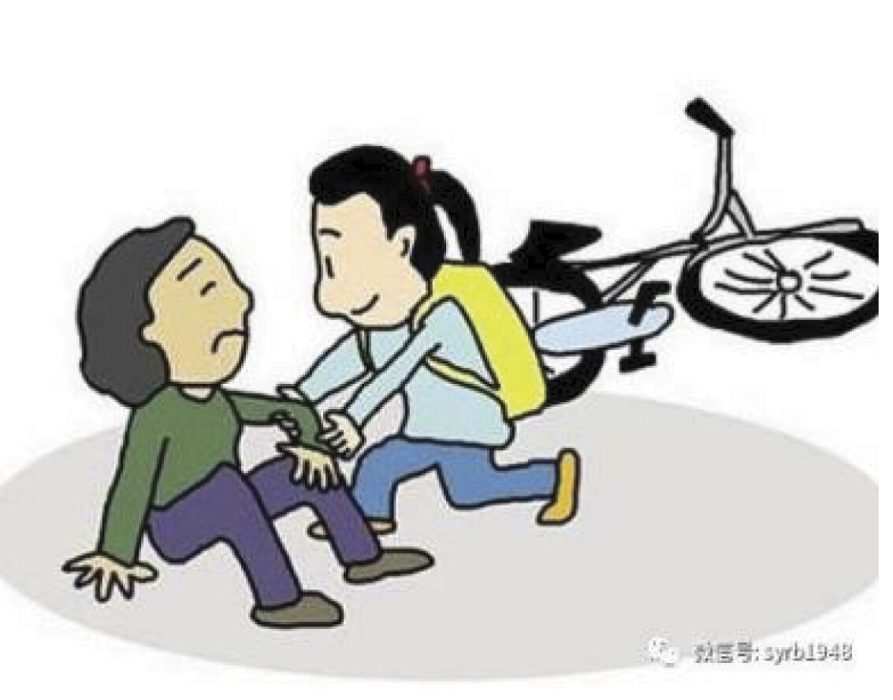
The tendency for some movies and television programs to make “heroes” out of violent, aggressive “bad guys” is particularly disturbing in light of these findings. In fact, Bandura began this research to investigate possible links between children’s exposure to violence on television and aggressive behavior toward others.
Prosocial behavior, which is behavior aimed at helping others, has also been shown to be influenced by media consumption. Studies have shown that when children watch media that models helping behavior, aggressive behavior decreases and prosocial behavior increases (Anderson et al., 2015; Prot et al., 2014).

Slide 59
cognitive abilities necessary for observational learning to occur (Bandura, 1977, 2001).
The learner must be able to
(1) pay attention to the model’s behavior and observe its consequences,
(2) remember what was observed,
(3) be able to reproduce the behavior, and
(4) be motivated to do so.
In other words: observational learning involves the ability to imagine and anticipate – thoughts and intentions are essential.
Bandura’s ‘agentic perspective’ draws our attention to the fact that cognitions motivate actions, and that a sense of self-efficacy (an individual’s belief in their own effectiveness) is essential for complex and social learning.
If you believe that you are simply incapable of giving a good presentation in class, you are unlikely to motivate

Slide 60
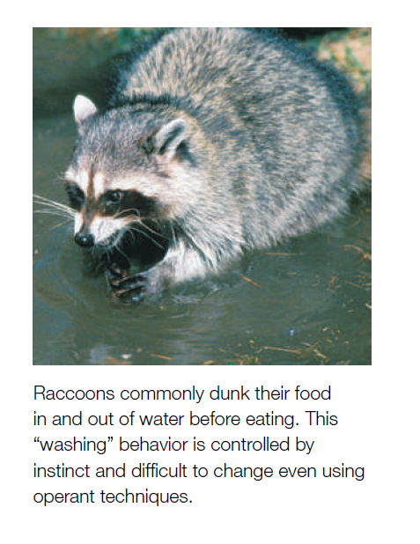
Biological Constrains
As the coins became more and more associated with food, the animals began to drift back into the instinctual patterns of behavior that they used with real food.
Raccoons rub their food between their paws and dip it in and out of water.
Pigs root and throw their food around before eating it.
The Brelands called this tendency to revert to genetically controlled patterns instinctive drift.

Slide 61
Schedules of Reinforcement
Skinner pointed out that in everyday life outside the psychology laboratory, our behavior is rarely reinforced every time it occurs (continuous reinforcement). E.g. babies, batsmen, bagger, singers, etc.
Fixed-interval schedule: interval might be 1 minute, 3 minutes, or any other fixed period of time. E.g. scheduled tests, monthly salary.
Fixed-ratio schedule: reinforcers are given only after the organism has made a specified number of responses. For example, the experimenter could reinforce after every 10th or 20th response. E.g. sales or produce jobs
faster rate of responding than does the fixed-interval schedule.
Nearly all reinforcement begins with continuous reinforcement then move towards intermittent.
But everyday life doesn’t always permit a fixed-interval or fixed-ratio reinforcement schedule.
3. Variable-interval schedule: the reinforcer might appear after 2 hours in the first instance, after 1 and a 1⁄2 hours the next time, and after 2 hours and 15 minutes the third time. E.g. fishing experiences
4. Variable-ratio schedule: reinforced after every n^{th} response on the average.
3 – 6 – 10 , so on.
After a high mean is reached, say 500, responses become extremely resistant to extinction.
Extinction: the tendency of a previously acquired response to become progressively weakened upon non-reinforcement.
e.g. playing with slot machines.
Superstitious behaviour

Slide 62
What are some possible waste disposal learning techniques?

Slide 63
as the coins became more and more associated with food, the animals began to
drift back into the instinctual patterns of behavior that they used with real food. Raccoons
rub their food between their paws and dip it in and out of water. Pigs root and throw their
food around before eating it. The Brelands called this tendency to revert to genetically controlled
patterns instinctive drift.

